Slide 1

A new ERA
For a SMART DUSTBIN

Slide 2
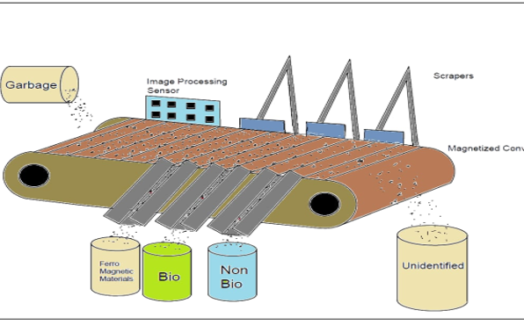
Brief Overview
A versatile approach to bring forward the application of image processing in the WASTE MANAGEMENT sector.
We aim to segregate our waste, where our programmable automation algorithms seek to perform the task and not us.
TASK AT HAND:-
installation of a vacuum compartment at ground level to suck in waste from a nearby radius.

Slide 3

THE SMART DUSTBIN
WE LIKE IT PRISTINE
An innovation , an idea , a concept to implement. The smart dustbin isn’t just a storage can , but an aim to revolutionize the thought of waste collection , differentiation and repudiation.
The war we fight ,yet isn’t of a mass eradication that too in a momentary lapse, but to mitigate the intricate imbalance in our strategies at levels as ground as localities, and let it further crave its way to higher statures.

Slide 4
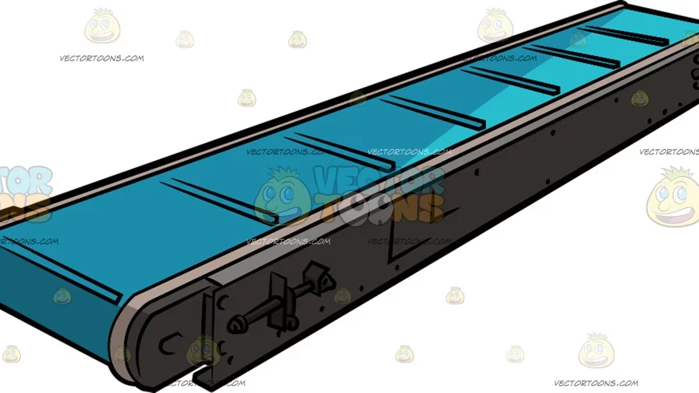
FEATURES/
Target categories:-
Biodegradable and non-biodegradable
To and fro rod motions to sort objects
Purpose of conveyor belt :-
To ensure smooth transition of waste as desired.
Image Processing to detect different types of waste
Algorithm based reprogrammable segregation as per user’s need.
Capacious to be a social dustbin

Slide 5
Advantages
Cost Effectiveness
Use of rod motions instead of installing manipulators for pickings.
User segregation efforts minimised
Image processing acts as an alternative to human sense of different wastes
Explicit variants can be brought to use
Algorithm modifications permit different categories to be ratified
Promotes a noble cause
Goes at par with the ‘SWACH BHARAT ABHIYAN’
Mini cleanliness check on a nearby radius

Slide 6


Thank You
FOR VIEWING THIS EFFORT MADE BY TEAM ENTERFACE
CONTRIBUTORS:-
Sparsh Ahuja
Sanskriti Agrawal
Shreyas Singh
Siddhant Lohia
Kuhu Pyasi
Sourav Saha

